Slide 1


Data Management Project
Data Warehouse: Design and implementation of a three layer architecture through ETL process, DFM schema, star schema, and relational DB environment.
Cured by Jacopo Maria Barile 2208592

Slide 2
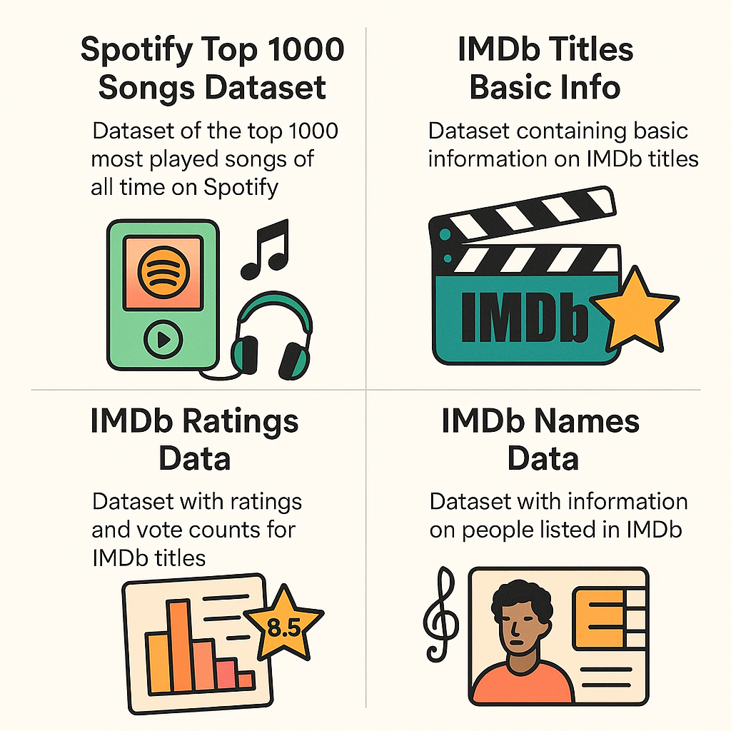
Phase 1.0: Source Layer
Selection of external and operational data.
Arts and Entertainment themes.
Kaggle Data Source.
IMDB Data Source.
4 different Datasets:
Spotify Top Tracks.
IMDB Titles.
IMDB Ratings.
IMDB Workers.

Slide 3




Phase 2.0: Data Staging
ETL Tools to process the external data sources.
2.1: Extraction and Cleansing.
2.2: DFM and Star Schema.
2.3: Transformation.
2.4: Loading.

Slide 4
Phase 2.1: Extraction and Cleansing
Process to improve data quality and pre-Transformation.
Static Extraction performed.
Cleansing of data inconsistencies:
Dropping duplicates.
Dropping rows with missing data.
Dropping useless Titles and Names data.
Dropping inconsistent Tracks data.
Join of cleansed datasets.
Fuzzy Matching of Tracks and Titles data.

Slide 5
Phase 2.2: DFM and Star Schema
Dimensional Fact Model.
3 Dimensions developed:
Artist.
Track.
Title.
Shared Hierarchy developed on the Artist Dimension.
Optional and Multiple Arcs developed.
Different Levels and Additivity of Measures developed.

Slide 6
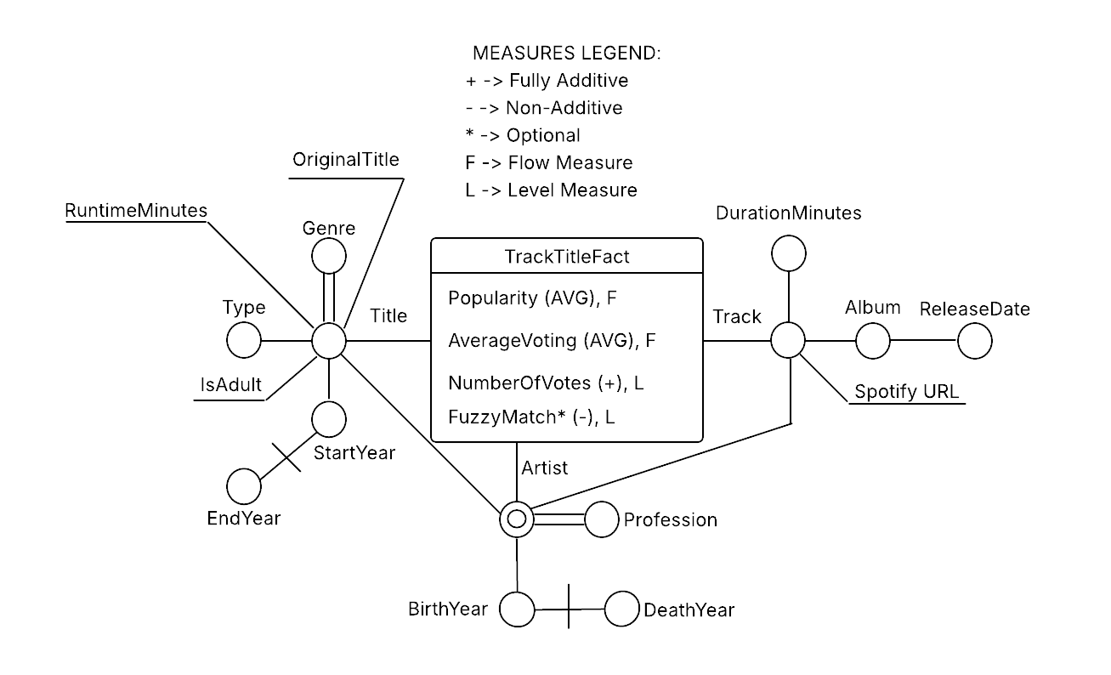
Phase 2.2: DFM and Star Schema
Dimensional Fact Model

Slide 7
Phase 2.2: DFM and Star Schema
Star Schema.
7 Dimension Tables developed.
Bridge Tables developed:
Bridge_Genre.
Bridge_Profession.
Foreign Keys and Integrity Constraints developed.
Optional Measures and Attributes developed.

Slide 8
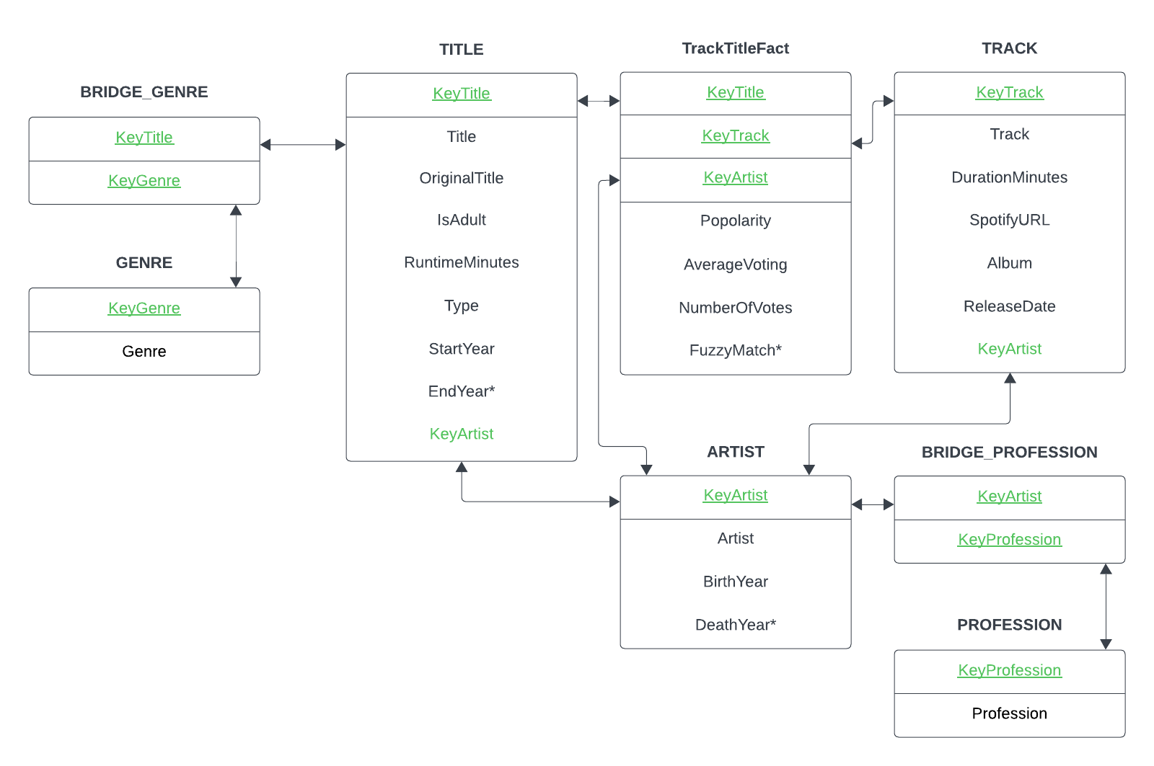
Phase 2.2: DFM and Star Schema
Dimensional Fact Model

Slide 9
Phase 2.3: Transformation
Reconciled Data Layer construction.
Conversion and Standardization performed:
Dimensions Attributes conversion.
Cleansing and Correction of inconsistencies.
Creation and Standardization of Dimensions.
Mapping between source Data Layer and Data Warehouse Layer performed.
No Meta-Data Integration needed.
Consistent and Correct Reconciled Data obtained.

Slide 10
Phase 2.4: Loading
Primary Data Warehouse Population.
PostGres environment: PGAdmin4.
Data Refresh performed.
Data Marts Organization and Population.
Concurrency Control and Serializability of Transactions performed.

Slide 11
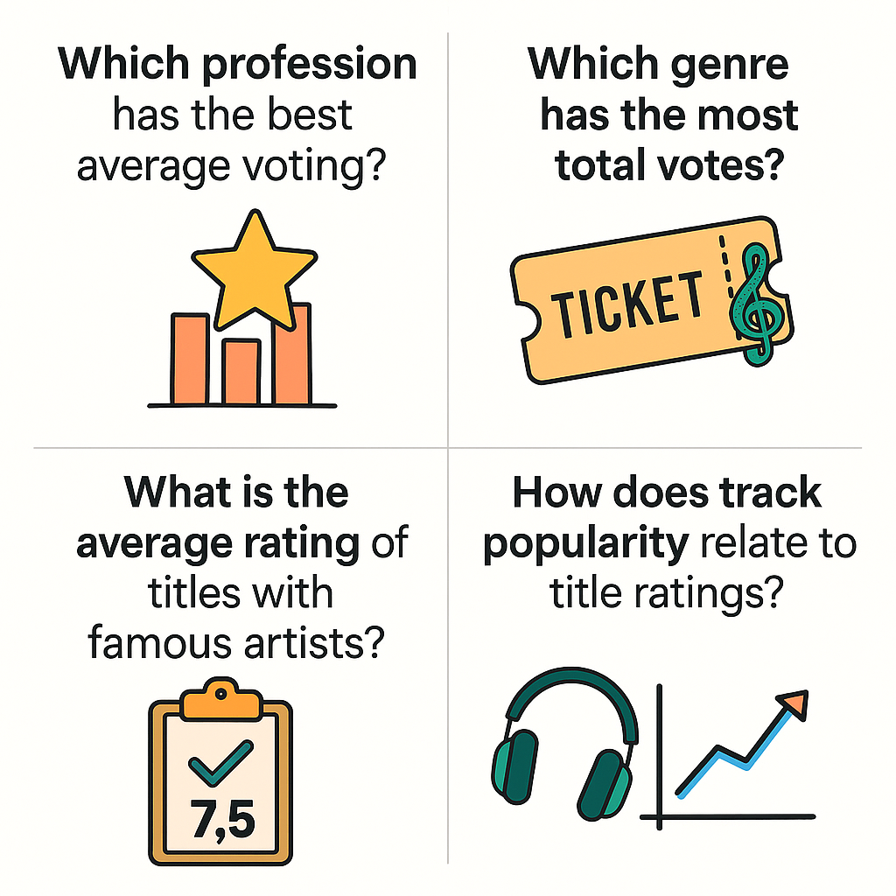
Phase 3.0: Analysis Layer
Olap Query Tools.
Trend and Quality of Reconciled Data Layer Analysis.
Audience engagement and Roles impact Analysis.
Cross-Platform and Multimedia Insights Analysis.
Popularity and Community Relevance Analysis.

Slide 12
THANKS FOR WATCHING!
Cured by Jacopo Maria Barile 2208592

